Slide 1
Language Design and Implementation
6CC509

Slide 2
Lecture plan: what this session covers
Who, what, why
Assessment:
Coursework 1
Coursework 2
What is a programming language
How do we divide up programming languages
Why do we divide up programming languages?
The fun hard bits of taking text and making programs
Lexical analysis
Parser (syntax analysis)
Semantic analysis
Intermediate representation generation
Optimisation
Code generation
Notes:
https://www.embedded.com/common-multicore-programming-problems-part-4-memory-cache-issues-and-consistency/
https://dl.acm.org/doi/abs/10.1145/1993478.1993481
https://en.wikipedia.org/wiki/Consistency_model
https://www.geeksforgeeks.org/computer-organization-and-architecture-pipelining-set-2-dependencies-and-data-hazard/

Slide 3

Who am I
Dr Christopher Windmill
Educational background
EngD System Level Integration, The University of Glasgow
Meng (Hons) Electronics and Computer Science, The University of Edinburgh
PGCert HE, Nottingham Trent University
Doctoral research area – future network routing architectures
Research interests in:
Virtual and augmented reality
Computing in healthcare/mental health
Serious games / computer games
Work background
Realtime high risk software and tools
Video streaming systems
Lecturing
Software development
Team projects
Games development
Networking/distributed systems
Research
Widely varied
digital twin asset management
Gamification of business processes
c.windmill@derby.ac.uk

Slide 4
Why and what?
Why
What
Computer languages are a cornerstone of practical and theoretical applications of computer science. Therefore, this module provides an in-depth and pragmatically focused exploration of the theory, concepts, paradigms, current research, and practical implementation issues involved in designing and implementing mark-up languages, special-purpose languages, and programming languages
Demonstrate a critical awareness of the theory and practical issues involved in implementing language parsers, compilers and interpreters
Design a computer language, and be able to implement significant portions of an interpreter and/or compiler for it

Slide 5
Coursework 1
You are required to produce an approximately 1500-word literature review related to a single area of cutting-edge developments in language design and implementation, or interpretation and compilation. You may wish to use resources from conferences such as https://www.sigplan.org/Conferences/ as a guide to topic areas and current research.
A non-exhaustive list of potential topics includes:
Static/dynamic code analysis
Parallelism and concurrency
Code optimisation
Garbage collection and language security
Interaction of AI and programmers/languages

Slide 6
Coursework 1 rubric - introduction
Criteria | Excellent (1st) 7-10 | Very Good (2:1) 6-7 | Good (2:2) 5-6 | Satisfactory (3rd) 4-5 | Near Fail (N:F) 3.5-4
Introduction (10%) | Clear articulation of the research topic, purpose, and scope. Background information provides clear explanation of where the topic fits within the field and provides justification and rationale for coverage of this topic. | Clear articulation of the research topic and purpose. Background information provides reasonable explanation of where the topic fits within the field and provides justification for coverage of this topic. | Adequate articulation of the research topic. Background information provides somewhat clear explanation of where the topic fits within the field and provides limited justification for coverage of this topic. | Limited articulation of the research topic. Background information provides somewhat unclear explanation of where the topic fits within the field with little to no justification for coverage of this topic. | Poor articulation of the research topic. Background information is insufficient.

Slide 7
Coursework 1 rubric - Structure
Criteria | Excellent (1st) 7-10 | Very Good (2:1) 6-7 | Good (2:2) 5-6 | Satisfactory (3rd) 4-5 | Near Fail (N:F) 3.5-4
Organization and Structure (10%) | Well-organized with a logical flow and clear structure. Code examples, images, or tables are included and correctly captioned/reference. Effective use of headings and subheadings. Transitions between sections are smooth. | Well-organized with a clear structure. Code examples, images, or tables are included and correctly captioned/reference. Effective use of headings. Transitions are generally smooth. | Adequately organized with some room for improvement. At least one code example, image, or table is included and correctly captioned/reference. Headings and structure are somewhat unclear. Transitions could be smoother. | Poorly organized with a confusing structure. No code examples, images, or tables, or incorrectly captioned/referenced. Limited use of headings. Transitions are abrupt. | Chaotic organization with no clear structure. No use of headings. Transitions are non-existent.

Slide 8
Coursework 1 rubric - Coverage
Criteria | Excellent (1st) 7-10 | Very Good (2:1) 6-7 | Good (2:2) 5-6 | Satisfactory (3rd) 4-5 | Near Fail (N:F) 3.5-4
Coverage and Synthesis (30%) | Comprehensive coverage of relevant literature from academic and non-academic sources. Clear synthesis and integration of ideas from referenced content. Thorough analysis of key concepts and findings. | Thorough coverage of relevant literature from either academic or non-academic sources but missing depth in one of these. Effective synthesis of ideas from referenced content. Analysis of key concepts and findings shows limited understanding of the topic area. | Adequate coverage of literature from a mixture of academic and non-academic sources, however with large gaps. Some gaps in synthesis and integration. Analysis is somewhat lacking or is purely surface level. | Limited coverage of relevant literature, solely from non-academic sources. Weak synthesis and integration of ideas. Analysis is minimal or shows little understanding of the topic area. | Incomplete coverage of literature. No synthesis or integration evident. No analysis provided.

Slide 9
Coursework 1 rubric – critical evaluation
Criteria | Excellent (1st) 7-10 | Very Good (2:1) 6-7 | Good (2:2) 5-6 | Satisfactory (3rd) 4-5 | Near Fail (N:F) 3.5-4
Critical Evaluation (20%) | Thoughtful and critical evaluation of the strengths and weaknesses of the literature. Insightful critique of methodologies, theories, and arguments. | Good critical evaluation of the literature. Identification of strengths and weaknesses. Some insightful critique that shows wider reading on the topic. | Adequate critical evaluation. Limited identification of strengths and weaknesses. Basic critique is provided but shows limited additional reading. | Superficial critical evaluation. Weak identification of strengths and weaknesses. Minimal critique that shows little to no understanding of the topic area. | Lack of critical evaluation. No identification of strengths and weaknesses. No critique provided.

Slide 10
Coursework 1 rubric - Clarity
Criteria | Excellent (1st) 7-10 | Very Good (2:1) 6-7 | Good (2:2) 5-6 | Satisfactory (3rd) 4-5 | Near Fail (N:F) 3.5-4
Clarity of Writing (10%) | Clear and concise writing. Well-structured sentences. Professional and scholarly tone. | Mostly clear and concise writing. Well-constructed sentences. Generally professional and scholarly tone. | Writing is somewhat clear and concise. Some sentences may be unclear. Tone is adequate. | Writing lacks clarity. Sentences are often unclear. Tone needs improvement. | Poorly written with little clarity. Numerous sentences are unclear. Tone is unprofessional

Slide 11
Coursework 1 rubric - Conclusions
Criteria | Excellent (1st) 7-10 | Very Good (2:1) 6-7 | Good (2:2) 5-6 | Satisfactory (3rd) 4-5 | Near Fail (N:F) 3.5-4
Conclusion (10%) | Summarizes key findings and insights from the literature. Formulates clear conclusions backed up within the work. | Summarizes key findings. Conclusions are generally clear but may lack some support from the work. | Summarizes findings with some omissions. Conclusions are somewhat unclear and may lack support in the work. | Limited summary of findings. Conclusions lack clarity and support from the work. | No meaningful summary or conclusions provided.

Slide 12
Coursework 1 rubric - Referencing
Criteria | Excellent (1st) 7-10 | Very Good (2:1) 6-7 | Good (2:2) 5-6 | Satisfactory (3rd) 4-5 | Near Fail (N:F) 3.5-4
References and Citations (10%) | Accurate and complete citation of sources. Follows a consistent citation style. | Mostly accurate and complete citation of sources. Minor inconsistencies in citation style. | Some inaccuracies in citation. Inconsistent citation style. | Numerous inaccuracies in citation. Inconsistent citation style. | References and citations are missing or severely flawed.

Slide 13
Coursework 2
The assessment is separated into distinct stages of necessary functionality. As such, you will need to implement progressively more advanced features for higher marks.
Lab sessions are focused on building the foundations necessary to bootstrap your programming language up to a simple postfix-to-infix expression parser. From there, you will be free to modify functionality within the requirements of each stage.

Slide 14
Domain-specific or general-purpose?
Functional or imperative/procedural or logic-deductive or mixed paradigm?
Turing-complete or not?
Declarative or imperative?
Dataflow / stream processing?
C-derived syntax, or something else?
Infix, prefix, postfix?
Text or graphical?
Simple grammar vs complex grammar.
Type system model?
Dynamically-typed or statically-typed?
Manifest typing or type inference?
Weakly-typed or strongly-typed?
Algebraic types? E.g., sum of products?
Modularisation? Namespaces?
Some sort of object-orientation? Or not?
Inheritance? Encapsulation? Polymorphism? Templates?Interfaces? Substitutability?
Functions/procedures/operators/predicates?
Constraints?
Lambdas, closures, continuations?
First-class… Functions, threads, control structures, variables, whatever?
Variables: Mutable or immutable?
Built-in arrays vs built-in containers vs library containers?
Built-in I/O vs I/O via library operators
Operator overloading? Operator overridding?
Automatic garbage collection or explicit memory management?
Lazy evaluation (and memoization?) vs eager evaluation?
Pointers vs References vs Value Semantics
Function pointers?
Pass by reference/value/name?
Comments that do special things?
See literate Haskell.
Annotations? See Java.
Esoteric or conventional?
Interpreter or compiler or transpiler?

Slide 15
Coursework 2 – Stage 1
As computers are nothing more than complicated calculators, it should be no surprise that the first step in language development is the creation of a simple arithmetic expression parser. Start by implementing a program that accepts the path to a source file containing an arithmetic expression on any valid real numbers in infix notation. The program should be capable of parsing the contents of the input file, executing its expressions, and printing the product.
Your parser should – at a minimum – handle:
Parenthesis.
unary negation.
binary addition, subtraction, multiplication, and division.
With any combination of these arithmetic operators, your parser should be capable of producing correct outputs. At this stage each line within the source file can be treated as independent as no variable storage/memory is required.
Example inputs that you will want to test against include but are not limited to:
1 – 2
2.5 + 2.5 - 1.25
(10 * 2) / 6
8.5 / (2 * 9) - -3
How you handle the storing of data required for the computation is entirely up to you. A popular approach is to parse the symbols to an imaginary instruction set and then execute them one-by-one (a virtual machine). Another approach is to parse the symbols into a tree of nodes and traverse it, executing the logic defined in each node (an abstract syntax tree).
On Regex: while implementing the parsing logic, you may be tempted to reach for regular expressions (regex). If all you were going to parse is numbers and arithmetic operators, this would be a reasonable approach, however it is not a scalable solution for programming language parsers

Slide 16
Coursework 2 – Stage 2
Booleans are foundational to all conditional logic in programming languages and will be necessary for control flow functionality introduced in later stages. After implementing support for numbers, further extend it to support Booleans and Boolean-producing expressions.
Your parser should – at a minimum – handle:
Binary comparison, equality, and inequality between numbers.
Binary equality and inequality between Booleans.
Logical “AND” and “OR” between Booleans.
Unary negation of Booleans.
With any combination of the above arithmetic expressions, your parser should be capable of producing correct outputs. At this stage each line within the source file can be treated as independent as no variable storage/memory is required.
Example inputs that you will want to test against include but are not limited to:
true == false
true != false
(5 < 10)
!(5 – 4 > 3 * 2 == !false)
true and true
false and true
(0 < 1) or false
false or false
How you want to handle comparison, equality, and inequality across types is left to you. For example, JavaScript considers 1 == true. In stricter type systems, this would be considered an illegal comparison. Whichever approach you choose, will be expected to defend your decision in your Viva. You should also consider operator precedence in this section as several languages you have already studied will not evaluate these examples to the same value.

Slide 17
Coursework 2 – Stage 3
Text is a necessary component of any programming language that wishes to communicate with the end-user. In C, we have fixed-size character buffers, whereas in JavaScript we have dynamic string types.
Once you have real number and Boolean expressions working, further expand your language to support text values. Text values should be declarable by writing a string literal, such as "hello world".
Your parser should – at a minimum – handle:
binary concatenation of text values.
binary equality and inequality between text values.
For top marks in this stage, you will want to consider how other languages handle embedding non-printable character codes into text and handle them accordingly in your parser.
With any combination of these operations, your parser should be capable of producing correct outputs.
"hello" + " " + "world"
"foo" + "bar" == "foobar"
"10 corgis" != "10" + "corgis"
Above is an example of how text values may work in your language. Use these examples – adjusted for your own language syntax – to test your implementation works as expected.
The introduction of a new type in your language means new considerations surrounding how they should all interact with each other. For example, what is the behaviour of 1 + "0", and should false == "false"? You are expected to decide how to handle this and defend your decision during your viva.

Slide 18
Coursework 2 – Stage 4
Currently, only one expression may be computed per execution. This is less than adequate for more complex computer programs, which will want to compute many different values over their lifetime. For completion of stage 4, you are expected to implement support for global variables that may be assigned to, read from, and printed.
quickMaths = 9 + 10
Above is a simple example of how assigning to global variables might work in your language. When a global get or set operation is performed, your interpreter should look up a global variable matching that name and perform the appropriate get or set operation.
quickMaths = quickMaths + 2
Accumulation of operations on existing values should be supported by using the global variable recursively in its own expression, as shown above.
print quickMaths
The printing operation may work however you wish. The above example takes inspiration from the built-in print operation in Python 2. In Python 3, this was changed to use a regular function call syntax.
Your parser should – at a minimum – handle:
Creation, reading and display of named global variables.
Stage 1, 2, and 3 operations on global variables with consistent types.
Stage 1, 2, and 3 operations on global variables requiring appropriate type conversion.
Generation of an error value, state, or process for invalid type conversions.
With any combination of these operations, your parser should be capable of producing correct outputs. Lines of code in your source file cannot now be treated as independent.
quickMaths = 10 quickMaths = quickMaths + 2 print quickMaths
floatTest = 1.0 floatTest = floatTest + 5 print floatTest
stringCatTest = “10 corgis” stringCatTest = stringCatTest + 5 + “ more corgis” print stringCatTest
errorTest = 5 errorTest = errorTest + “insert string here” print errorTest
You will want to consider how you denote the end of expressions. Many C-like languages use semi-colons to mark the end of an expression or statement, while newlines are the preferred approach in other languages. This is a design decision left up to you, which you will be expected to defend in your viva.
For top marks in this stage, you will want to minimise the amount of work performed each time a variable is read from or written to. To start, you will want to make sure the data structure you are storing global variables in has a reasonable time complexity for the random access of string index values.

Slide 19
Coursework 2 – Stage 5
By this stage, your language should be close to Turing complete. Correct completion of stage 5 requires the implementation of if statements, condition-based repetitive logic, and some way to read input from the end-user of the program.
is_running = true shopping_list = "“ while (is_running == true) { item = input("add an item to the shopping list: ") if (item == "") { is_running = false } shopping_list = shopping_list + ", " + item
} print shopping_list
Above is an example of some pseudo-code demonstrating how the requirements might be implemented alongside composing all previous stages of functionality.
How you decide to implement the requirements is entirely up to you. It is not expected that your language look exactly like this, but it should be able to write the above program in one way or another. Whichever way you approach implementing these features, you will be expected to defend them in your viva.
For marks in the 60-70% range your parser should – at a minimum – handle:
While loops.
If-then statements.
For marks in the 70-80% range your parser should – at a minimum – handle:
Nested while loops.
If-then-else statements.
Nested if-then-else statements.

Slide 20
Coursework 2 – Stage 6
Now that you have a minimum implementation of a programming language, you can begin to extend it with convenient functionality and syntactic sugar to make it nicer to use. Each additional feature listed has a grade mark that is relative to its implementation difficulty. It is recommended that you implement easy features first, rather than jump immediately into the top-mark tasks.
List Data Structure (10%)
There is currently no way to associate many individual values as a list in your language. Implement some form of list-like data structure type that supports back-insertion, random removal, and random access with number-based indices.
Dictionary Data Structure (10%)
Dictionaries, sometimes referred to as associative arrays, are a very versatile data structure in that they can mimic any other data structure with varying efficiency. Implement some form of dictionary-like data structure type that supports assigning, removing, and querying for any type of value with any type of key.
Function-Based Code Reusability (10%)
Functions are a popular approach to encapsulating a simple unit of execution into reusable logic that may be called from elsewhere. Implement support for declaring and calling functions in your language.
Local Variables (15%)
Global variables are powerful; however, they are often considered an anti-pattern. Within the domain of dynamically typed languages specifically, global variables are also far-more difficult to optimise. To resolve this, implement local variables into the parser and interpreter in an efficient manner.
Further Features
Should you have other ideas for things that you want to implement as part of your language, speak to your assignment tutors for guidance.

Slide 21
Some basic background
Language Design and Implementation – 6CC509

Slide 22
Imperative and declarative programming
Imperative programming is about commanding the computer to perform tasks, to change state, or perform actions.
Most languages you have encountered so far are likely imperative:
Basic, C, C++, Python
Sub-types include:
procedural which groups instructions into procedures,
object-oriented which groups instructions with the part of the state they operate on,

Slide 23
Imperative and declarative programming
Declarative programming is about telling the computer what it needs to achieve, not how it needs to achieve it.
Imperative languages try to avoid side-effects of operations in general
You will have (or will see) some languages such as:
SQL, LISP, Haskell
Sub-types include:
functional in which the desired result is declared as the value of a series of function applications,
logic in which the desired result is declared as the answer to a question about a system of facts and rules,
reactive in which the desired result is declared with data streams and the propagation of change

Slide 24
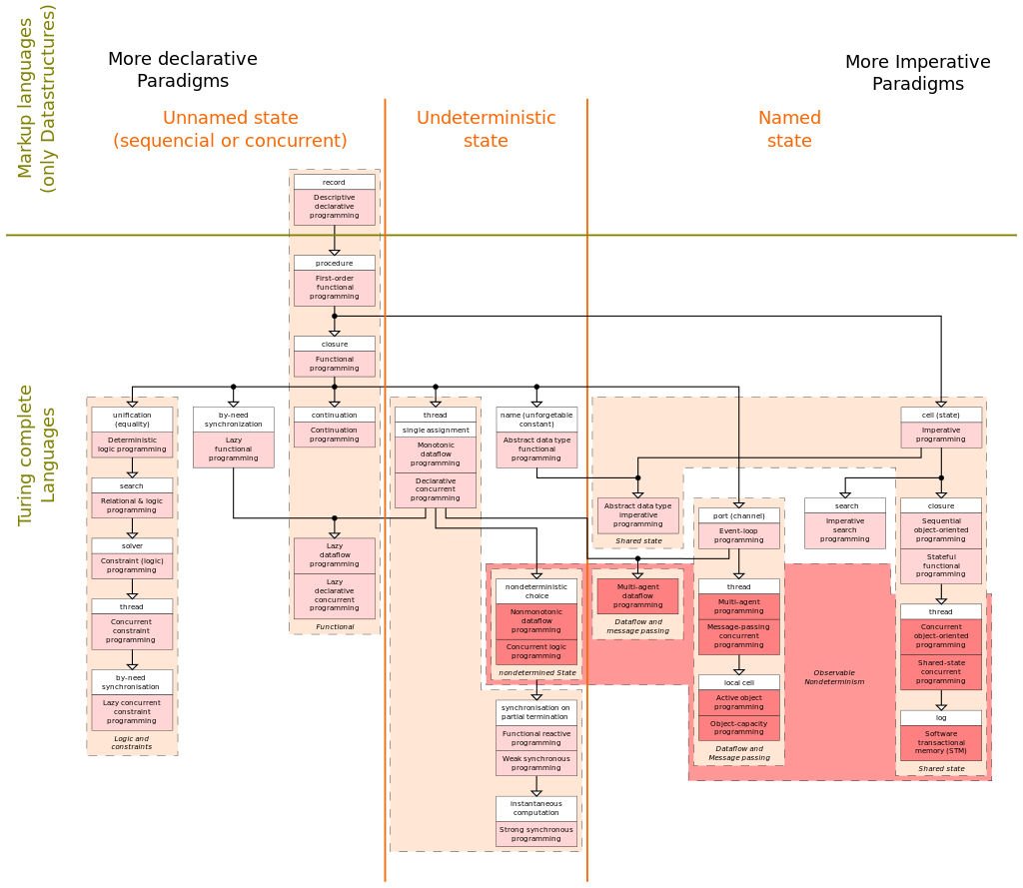
Notes:
https://en.wikipedia.org/wiki/Programming_paradigm#/media/File:Programming_paradigms.svg
More details
Overview of the various programming paradigms according to Peter Van Roy Peter Van Roy (2009-05-12). "Programming Paradigms: What Every Programmer Should Know" (PDF). info.ucl.ac.be. Retrieved 2014-01-27.
^ Peter Van-Roy; Seif Haridi (2004). Concepts, Techniques, and Models of Computer Programming. MIT Press. ISBN 978-0-262-22069-9.

Slide 25
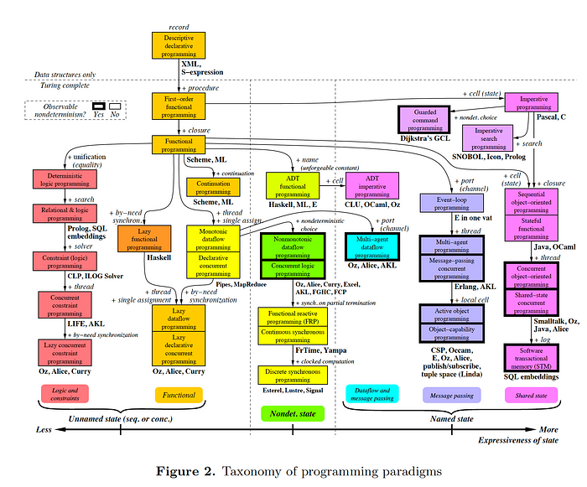
Notes:
A figure showing taxonomy of programming paradigms. Cited from Van Roy, “Programming Paradigms for Dummies,” page 13, figure 2, see https://www.info.ucl.ac.be/~pvr/VanRoyChapter.pdf.
https://www.youtube.com/watch?v=lqmMqtgWpms Vadim Zaytsev explains the poster

Slide 26
… really?
Almost no programming language follows only a single paradigm
If an idea works, why not steal it?
C: imperative, procedural
C++: imperative, object-oriented, generic, functional style(not functional)
C#: imperative, declarative, functional, generic, object-oriented(class-based), component-oriented
Java: concurrent, class-based, functional(Java8)
JavaScript: imperative, functional, object-oriented
Python: imperative, functional, procedural, object-oriented
Ruby: imperative, functional, object-oriented
SQL: declarative, data-driven
Notes:
List of paradigms from: https://medium.com/@jingchenjc2019/a-brief-survey-of-programming-paradigms-207543a84e2b

Slide 27
Examples of paradigms
Paradigm | Description | Main traits | Related paradigm(s) | Critique | Examples
Imperative | Programs as statements that directly change computed state (data fields) | Direct assignments, common data structures, global variables |  | Edsger W. Dijkstra, Michael A. Jackson | C, C++, Java, Kotlin, PHP, Python, Ruby
Structured | A style of imperative programming with more logical program structure | Structograms, indentation, no or limited use of goto statements | Imperative |  | C, C++, Java, Kotlin, Pascal, PHP, Python
Procedural | Derived from structured programming, based on the concept of modular programming or the procedure call | Local variables, sequence, selection, iteration, and modularization | Structured, imperative |  | C, C++, Lisp, PHP, Python
Functional | Treats computation as the evaluation of mathematical functions avoiding state and mutable data | Lambda calculus, compositionality, formula, recursion, referential transparency, no side effects | Declarative |  | C++,^{[2]} C#,^{[3][circular reference]} Clojure, CoffeeScript,^{[4]} Elixir, Erlang, F#, Haskell, Java (since version 8), Kotlin, Lisp, Python, R,^{[5]} Ruby, Scala, SequenceL, Standard ML, JavaScript, Elm
Event-driven including time-driven | Control flow is determined mainly by events, such as mouse clicks or interrupts including timer | Main loop, event handlers, asynchronous processes | Procedural, dataflow |  | JavaScript, ActionScript, Visual Basic, Elm
Object-oriented | Treats datafields as objects manipulated through predefined methods only | Objects, methods, message passing, information hiding, data abstraction, encapsulation, polymorphism, inheritance, serialization-marshalling | Procedural | See its Criticism selection, and elsewhere^{[6][7][8]} | Common Lisp, C++, C#, Eiffel, Java, Kotlin, PHP, Python, Ruby, Scala, JavaScript^{[9][10]}
Declarative | Defines program logic, but not detailed control flow | Fourth-generation languages, spreadsheets, report program generators |  |  | SQL, regular expressions, Prolog, OWL, SPARQL, Datalog, XSLT
Automata-based programming | Treats programs as a model of a finite state machine or any other formal automata | State enumeration, control variable, state changes, isomorphism, state-transition table | Imperative, event-driven |  | Abstract State Machine Language
Notes:
Some good notes: https://cs.lmu.edu/~ray/notes/paradigms/

Slide 28
A walk-through history
Structured programming:
Linearly executed code with jumps is hard to write well for the majority of programmers, we can leave it to the compiler to generate this kind of stuff.
Go To Statement Considered Harmful, by Edsger Dijkstra in 1968 -> Question, why?
Structured program theorem (or the Böhm–Jacopini theorem) states that sequencing, selection, and iteration are sufficient to express any computable function.
Sequence: run 1 subprogram followed by a second subprogram
Selection: run 1 of 2 subprograms based on a Boolean expression
Iteration: repeatedly run a subprogram while a Boolean expression is true
Thus, structured programming: subroutines/functions, block structures, and loops, and tests instead of lists of code with jumps/gotos.

Slide 29
A walk-through history
Procedural programming:
An evolution of structured programming to subdivide code (programs).
Divide the code into structured procedural blocks:
routines, subroutines (a block of code you can call)
modules methods (a subroutine defined within a class/module that normally acts on an instance of that class)
Procedures (a subroutine that returns nothing)
functions (a subroutine that returns a value)
Procedural programming generally offers some significant benefits over structured programming, including:
Division of functionality
Debugging and testing
Ease of maintenance
Reusability of code

Slide 30
A walk-through history
Object-orientated programming
An object is a composition of data and code that allows for numerous improvements over struct/method-based programming
It is often seen as a noun (numbers, strings, or variables) and verbs (functions) structure
A class is a definition of an object
We really love OOP for the following reasons:
Encapsulation
Inheritance
Interfaces
Polymorphism
SOLID is a mnemonic invented by Michael Feathers which spells out five software engineering design principles:
Single responsibility principle
Open/closed principle
Liskov substitution principle
Interface segregation principle
Dependency inversion principle

Slide 31
A walk-through history
Functional programming
Inspired by Alonzo Church’s λ-calculus from the 1930s.
Minimal construction of “abstractions” (functions) and substitutions (applications).
Lambda Calculus is Turing complete: a solution can be written to solve any problem solvable by a computer
Side effects:
Pure functional languages (like Haskell) limit side effects e.g. I/O and strongly enforce this to prevent leakage
Impure functional languages (like OCalm or F#) allow side effects at the discretion of the programmer
Iteration is represented by substituting loops for recursion
Often functional programs are:
Easier to read – they describe the outcome not the steps
Easier to debug and maintain
Easier to parallelize
Useful features:
Hindley–Milner type system (dynamic typing)
Lazy evaluation (don’t call stuff we don’t need)
Closures – increased flexibility to define functions and variable scope

Slide 32
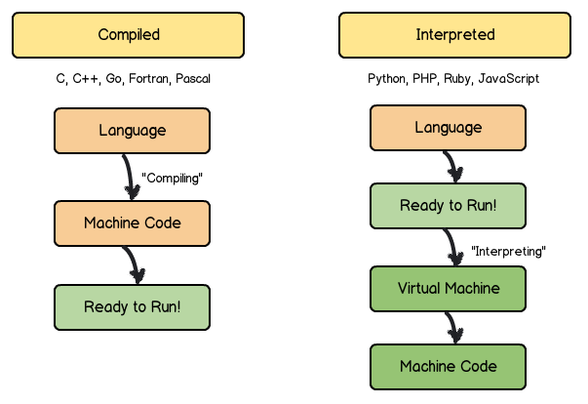
Compilation and interpretation

Slide 33
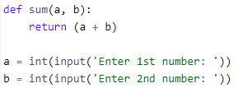
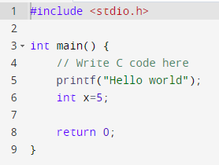
Lexical analysis
You can build regular expressions (REGEX), state machines (FSM), deterministic finite automata (DFA), or non-deterministic finite automata (NFA) – this is often easier than manual parsing.
https://www.owenstephens.co.uk/blog/2014/09/28/NFA_DFA.html
Lexers turn source code into tokens
A token is a “unit” of the language that generally has information about the source material:
Type, value, length, start index, line
In natural languages this is fairly easy, there are limited numbers of characters that can split “units”, e.g., “ , , , ., ;, :, !, ?, “, ‘” (and a few more)
Programming languages are generally strict about the structure of the language, but involve more nesting.
Python example
C Example
Token: Type: keyword
Value: def
Start: 0
Line: 1
Length: 3
Token: Type: identifier
Value: x=5
Start: 6
Line: 6
Length: 3
Token: Type: identifier
Value: x
Start: 6
Line: 6
Length: 1
Notes:
https://tajseer.files.wordpress.com/2014/06/re-nfa-dfa.pdf

Slide 34
Sometimes it’s not easy
What is a valid email address?
https://www.ietf.org/rfc/rfc0822.txt
address = mailbox ; one addressee
mailbox = addr-spec ; simple address
addr-spec = local-part "@" domain ; global address
local-part = word *("." word) ; uninterpreted
; case-preserved
domain = sub-domain *("." sub-domain)
sub-domain = domain-ref / domain-literal
domain-ref = atom ; symbolic reference
atom = 1*<any CHAR except specials, SPACE and CTLs>
(?:(?:\r\n)?[ \t])*(?:(?:(?:[^()<>@,;:\\".\[\] \000-\031]+(?:(?:(?:\r\n)?[ \t] )+|\Z|(?=[\["()<>@,;:\\".\[\]]))|"(?:[^\"\r\\]|\\.|(?:(?:\r\n)?[ \t]))*"(?:(?: \r\n)?[ \t])*)(?:\.(?:(?:\r\n)?[ \t])*(?:[^()<>@,;:\\".\[\] \000-\031]+(?:(?:( ?:\r\n)?[ \t])+|\Z|(?=[\["()<>@,;:\\".\[\]]))|"(?:[^\"\r\\]|\\.|(?:(?:\r\n)?[ \t]))*"(?:(?:\r\n)?[ \t])*))*@(?:(?:\r\n)?[ \t])*(?:[^()<>@,;:\\".\[\] \000-\0 31]+(?:(?:(?:\r\n)?[ \t])+|\Z|(?=[\["()<>@,;:\\".\[\]]))|\[([^\[\]\r\\]|\\.)*\ ](?:(?:\r\n)?[ \t])*)(?:\.(?:(?:\r\n)?[ \t])*(?:[^()<>@,;:\\".\[\] \000-\031]+ (?:(?:(?:\r\n)?[ \t])+|\Z|(?=[\["()<>@,;:\\".\[\]]))|\[([^\[\]\r\\]|\\.)*\](?: (?:\r\n)?[ \t])*))*|(?:[^()<>@,;:\\".\[\] \000-\031]+(?:(?:(?:\r\n)?[ \t])+|\Z |(?=[\["()<>@,;:\\".\[\]]))|"(?:[^\"\r\\]|\\.|(?:(?:\r\n)?[ \t]))*"(?:(?:\r\n) ?[ \t])*)*\<(?:(?:\r\n)?[ \t])*(?:@(?:[^()<>@,;:\\".\[\] \000-\031]+(?:(?:(?:\ r\n)?[ \t])+|\Z|(?=[\["()<>@,;:\\".\[\]]))|\[([^\[\]\r\\]|\\.)*\](?:(?:\r\n)?[ \t])*)(?:\.(?:(?:\r\n)?[ \t])*(?:[^()<>@,;:\\".\[\] \000-\031]+(?:(?:(?:\r\n) ?[ \t])+|\Z|(?=[\["()<>@,;:\\".\[\]]))|\[([^\[\]\r\\]|\\.)*\](?:(?:\r\n)?[ \t] )*))*(?:,@(?:(?:\r\n)?[ \t])*(?:[^()<>@,;:\\".\[\] \000-\031]+(?:(?:(?:\r\n)?[ \t])+|\Z|(?=[\["()<>@,;:\\".\[\]]))|\[([^\[\]\r\\]|\\.)*\](?:(?:\r\n)?[ \t])* )(?:\.(?:(?:\r\n)?[ \t])*(?:[^()<>@,;:\\".\[\] \000-\031]+(?:(?:(?:\r\n)?[ \t] )+|\Z|(?=[\["()<>@,;:\\".\[\]]))|\[([^\[\]\r\\]|\\.)*\](?:(?:\r\n)?[ \t])*))*) *:(?:(?:\r\n)?[ \t])*)?(?:[^()<>@,;:\\".\[\] \000-\031]+(?:(?:(?:\r\n)?[ \t])+ |\Z|(?=[\["()<>@,;:\\".\[\]]))|"(?:[^\"\r\\]|\\.|(?:(?:\r\n)?[ \t]))*"(?:(?:\r \n)?[ \t])*)(?:\.(?:(?:\r\n)?[ \t])*(?:[^()<>@,;:\\".\[\] \000-\031]+(?:(?:(?: \r\n)?[ \t])+|\Z|(?=[\["()<>@,;:\\".\[\]]))|"(?:[^\"\r\\]|\\.|(?:(?:\r\n)?[ \t ]))*"(?:(?:\r\n)?[ \t])*))*@(?:(?:\r\n)?[ \t])*(?:[^()<>@,;:\\".\[\] \000-\031 ]+(?:(?:(?:\r\n)?[ \t])+|\Z|(?=[\["()<>@,;:\\".\[\]]))|\[([^\[\]\r\\]|\\.)*\]( ?:(?:\r\n)?[ \t])*)(?:\.(?:(?:\r\n)?[ \t])*(?:[^()<>@,;:\\".\[\] \000-\031]+(? :(?:(?:\r\n)?[ \t])+|\Z|(?=[\["()<>@,;:\\".\[\]]))|\[([^\[\]\r\\]|\\.)*\](?:(? :\r\n)?[ \t])*))*\>(?:(?:\r\n)?[ \t])*)|(?:[^()<>@,;:\\".\[\] \000-\031]+(?:(? :(?:\r\n)?[ \t])+|\Z|(?=[\["()<>@,;:\\".\[\]]))|"(?:[^\"\r\\]|\\.|(?:(?:\r\n)? [ \t]))*"(?:(?:\r\n)?[ \t])*)*:(?:(?:\r\n)?[ \t])*(?:(?:(?:[^()<>@,;:\\".\[\] \000-\031]+(?:(?:(?:\r\n)?[ \t])+|\Z|(?=[\["()<>@,;:\\".\[\]]))|"(?:[^\"\r\\]| \\.|(?:(?:\r\n)?[ \t]))*"(?:(?:\r\n)?[ \t])*)(?:\.(?:(?:\r\n)?[ \t])*(?:[^()<> @,;:\\".\[\] \000-\031]+(?:(?:(?:\r\n)?[ \t])+|\Z|(?=[\["()<>@,;:\\".\[\]]))|" (?:[^\"\r\\]|\\.|(?:(?:\r\n)?[ \t]))*"(?:(?:\r\n)?[ \t])*))*@(?:(?:\r\n)?[ \t] )*(?:[^()<>@,;:\\".\[\] \000-\031]+(?:(?:(?:\r\n)?[ \t])+|\Z|(?=[\["()<>@,;:\\ ".\[\]]))|\[([^\[\]\r\\]|\\.)*\](?:(?:\r\n)?[ \t])*)(?:\.(?:(?:\r\n)?[ \t])*(? :[^()<>@,;:\\".\[\] \000-\031]+(?:(?:(?:\r\n)?[ \t])+|\Z|(?=[\["()<>@,;:\\".\[ \]]))|\[([^\[\]\r\\]|\\.)*\](?:(?:\r\n)?[ \t])*))*|(?:[^()<>@,;:\\".\[\] \000- \031]+(?:(?:(?:\r\n)?[ \t])+|\Z|(?=[\["()<>@,;:\\".\[\]]))|"(?:[^\"\r\\]|\\.|( ?:(?:\r\n)?[ \t]))*"(?:(?:\r\n)?[ \t])*)*\<(?:(?:\r\n)?[ \t])*(?:@(?:[^()<>@,; :\\".\[\] \000-\031]+(?:(?:(?:\r\n)?[ \t])+|\Z|(?=[\["()<>@,;:\\".\[\]]))|\[([ ^\[\]\r\\]|\\.)*\](?:(?:\r\n)?[ \t])*)(?:\.(?:(?:\r\n)?[ \t])*(?:[^()<>@,;:\\" .\[\] \000-\031]+(?:(?:(?:\r\n)?[ \t])+|\Z|(?=[\["()<>@,;:\\".\[\]]))|\[([^\[\ ]\r\\]|\\.)*\](?:(?:\r\n)?[ \t])*))*(?:,@(?:(?:\r\n)?[ \t])*(?:[^()<>@,;:\\".\ [\] \000-\031]+(?:(?:(?:\r\n)?[ \t])+|\Z|(?=[\["()<>@,;:\\".\[\]]))|\[([^\[\]\ r\\]|\\.)*\](?:(?:\r\n)?[ \t])*)(?:\.(?:(?:\r\n)?[ \t])*(?:[^()<>@,;:\\".\[\] \000-\031]+(?:(?:(?:\r\n)?[ \t])+|\Z|(?=[\["()<>@,;:\\".\[\]]))|\[([^\[\]\r\\] |\\.)*\](?:(?:\r\n)?[ \t])*))*)*:(?:(?:\r\n)?[ \t])*)?(?:[^()<>@,;:\\".\[\] \0 00-\031]+(?:(?:(?:\r\n)?[ \t])+|\Z|(?=[\["()<>@,;:\\".\[\]]))|"(?:[^\"\r\\]|\\ .|(?:(?:\r\n)?[ \t]))*"(?:(?:\r\n)?[ \t])*)(?:\.(?:(?:\r\n)?[ \t])*(?:[^()<>@, ;:\\".\[\] \000-\031]+(?:(?:(?:\r\n)?[ \t])+|\Z|(?=[\["()<>@,;:\\".\[\]]))|"(? :[^\"\r\\]|\\.|(?:(?:\r\n)?[ \t]))*"(?:(?:\r\n)?[ \t])*))*@(?:(?:\r\n)?[ \t])* (?:[^()<>@,;:\\".\[\] \000-\031]+(?:(?:(?:\r\n)?[ \t])+|\Z|(?=[\["()<>@,;:\\". \[\]]))|\[([^\[\]\r\\]|\\.)*\](?:(?:\r\n)?[ \t])*)(?:\.(?:(?:\r\n)?[ \t])*(?:[ ^()<>@,;:\\".\[\] \000-\031]+(?:(?:(?:\r\n)?[ \t])+|\Z|(?=[\["()<>@,;:\\".\[\] ]))|\[([^\[\]\r\\]|\\.)*\](?:(?:\r\n)?[ \t])*))*\>(?:(?:\r\n)?[ \t])*)(?:,\s*( ?:(?:[^()<>@,;:\\".\[\] \000-\031]+(?:(?:(?:\r\n)?[ \t])+|\Z|(?=[\["()<>@,;:\\ ".\[\]]))|"(?:[^\"\r\\]|\\.|(?:(?:\r\n)?[ \t]))*"(?:(?:\r\n)?[ \t])*)(?:\.(?:( ?:\r\n)?[ \t])*(?:[^()<>@,;:\\".\[\] \000-\031]+(?:(?:(?:\r\n)?[ \t])+|\Z|(?=[ \["()<>@,;:\\".\[\]]))|"(?:[^\"\r\\]|\\.|(?:(?:\r\n)?[ \t]))*"(?:(?:\r\n)?[ \t ])*))*@(?:(?:\r\n)?[ \t])*(?:[^()<>@,;:\\".\[\] \000-\031]+(?:(?:(?:\r\n)?[ \t ])+|\Z|(?=[\["()<>@,;:\\".\[\]]))|\[([^\[\]\r\\]|\\.)*\](?:(?:\r\n)?[ \t])*)(? :\.(?:(?:\r\n)?[ \t])*(?:[^()<>@,;:\\".\[\] \000-\031]+(?:(?:(?:\r\n)?[ \t])+| \Z|(?=[\["()<>@,;:\\".\[\]]))|\[([^\[\]\r\\]|\\.)*\](?:(?:\r\n)?[ \t])*))*|(?: [^()<>@,;:\\".\[\] \000-\031]+(?:(?:(?:\r\n)?[ \t])+|\Z|(?=[\["()<>@,;:\\".\[\ ]]))|"(?:[^\"\r\\]|\\.|(?:(?:\r\n)?[ \t]))*"(?:(?:\r\n)?[ \t])*)*\<(?:(?:\r\n) ?[ \t])*(?:@(?:[^()<>@,;:\\".\[\] \000-\031]+(?:(?:(?:\r\n)?[ \t])+|\Z|(?=[\[" ()<>@,;:\\".\[\]]))|\[([^\[\]\r\\]|\\.)*\](?:(?:\r\n)?[ \t])*)(?:\.(?:(?:\r\n) ?[ \t])*(?:[^()<>@,;:\\".\[\] \000-\031]+(?:(?:(?:\r\n)?[ \t])+|\Z|(?=[\["()<> @,;:\\".\[\]]))|\[([^\[\]\r\\]|\\.)*\](?:(?:\r\n)?[ \t])*))*(?:,@(?:(?:\r\n)?[ \t])*(?:[^()<>@,;:\\".\[\] \000-\031]+(?:(?:(?:\r\n)?[ \t])+|\Z|(?=[\["()<>@, ;:\\".\[\]]))|\[([^\[\]\r\\]|\\.)*\](?:(?:\r\n)?[ \t])*)(?:\.(?:(?:\r\n)?[ \t] )*(?:[^()<>@,;:\\".\[\] \000-\031]+(?:(?:(?:\r\n)?[ \t])+|\Z|(?=[\["()<>@,;:\\ ".\[\]]))|\[([^\[\]\r\\]|\\.)*\](?:(?:\r\n)?[ \t])*))*)*:(?:(?:\r\n)?[ \t])*)? (?:[^()<>@,;:\\".\[\] \000-\031]+(?:(?:(?:\r\n)?[ \t])+|\Z|(?=[\["()<>@,;:\\". \[\]]))|"(?:[^\"\r\\]|\\.|(?:(?:\r\n)?[ \t]))*"(?:(?:\r\n)?[ \t])*)(?:\.(?:(?: \r\n)?[ \t])*(?:[^()<>@,;:\\".\[\] \000-\031]+(?:(?:(?:\r\n)?[ \t])+|\Z|(?=[\[ "()<>@,;:\\".\[\]]))|"(?:[^\"\r\\]|\\.|(?:(?:\r\n)?[ \t]))*"(?:(?:\r\n)?[ \t]) *))*@(?:(?:\r\n)?[ \t])*(?:[^()<>@,;:\\".\[\] \000-\031]+(?:(?:(?:\r\n)?[ \t]) +|\Z|(?=[\["()<>@,;:\\".\[\]]))|\[([^\[\]\r\\]|\\.)*\](?:(?:\r\n)?[ \t])*)(?:\ .(?:(?:\r\n)?[ \t])*(?:[^()<>@,;:\\".\[\] \000-\031]+(?:(?:(?:\r\n)?[ \t])+|\Z |(?=[\["()<>@,;:\\".\[\]]))|\[([^\[\]\r\\]|\\.)*\](?:(?:\r\n)?[ \t])*))*\>(?:( ?:\r\n)?[ \t])*))*)?;\s*)

Slide 35
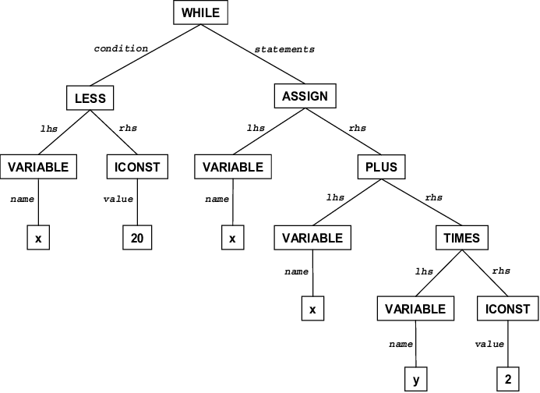
Parsing – syntax analysis
Parsing is the process of taking our tokens and generating an abstract syntax tree from it, i.e., a way to unambiguously represent the program we have generated.
At this point your lecturer is likely to go somewhat off-topic and start talking about reverse-polish notation and shunting yards!
N.B. we have now made use of n-ary trees, stacks, lists, ASCII values, and string manipulation! Think how this links to your other modules?
Notes:
https://en.wikipedia.org/wiki/Reverse_Polish_notation https://pmt.physicsandmathstutor.com/download/Computer-Science/A-level/Notes/AQA/03-Fundamentals-of-Algorithms/Advanced/3.3.%20Reverse%20Polish.pdf https://brilliant.org/wiki/shunting-yard-algorithm/ https://aquarchitect.github.io/swift-algorithm-club/Shunting%20Yard/ https://math.oxford.emory.edu/site/cs171/shuntingYardAlgorithm/

Slide 36
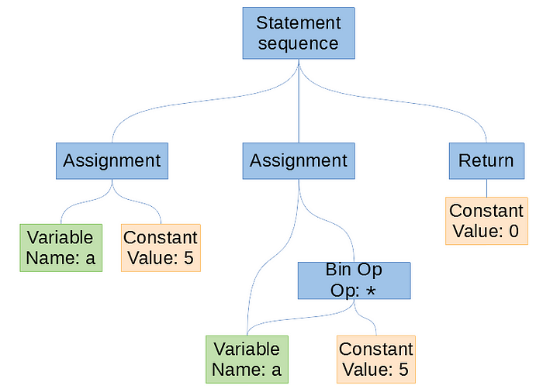
Pausing a second – lexxed, and parsed
Source code:
int main()
{ int a = 5; a = a * 5; return 0; }
Lexxed tokens:
[KEYWORD,"int"] [ID,"main"] [LPAREN] [RPAREN]
[LBRACE] [KEYWORD,"int"] [ID,"a"] [EQUALS] [INT,"5"] [SEMICOLON]
[ID,"a"] [EQUALS] [ID,"a"] [MULTIPLY] [INT,"5"] [SEMICOLON] [KEYWORD,"return"] [INT,"0"] [SEMICOLON] [RBRACE]
AST

Slide 37
Semantic analysis
Source code:
int main()
{ int a = 5; a = a * 5.0; return 0; }
Lexxed tokens:
[KEYWORD,"int"] [ID,"main"] [LPAREN] [RPAREN]
[LBRACE] [KEYWORD,"int"] [ID,"a"] [EQUALS] [INT,"5"] [SEMICOLON]
[ID,"a"] [EQUALS] [ID,"a"] [MULTIPLY] [FLOAT,"5.0"] [SEMICOLON] [KEYWORD,"return"] [INT,"0"] [SEMICOLON] [RBRACE]
AST

Slide 38
Semantic analysis
Source code:
int main()
{ int a = 5; a = a * 5.0; return 0; }
Lexxed tokens:
[KEYWORD,"int"] [ID,"main"] [LPAREN] [RPAREN]
[LBRACE] [KEYWORD,"int"] [ID,"a"] [EQUALS] [INT,"5"] [SEMICOLON]
[ID,"a"] [EQUALS] [ID,"a"] [MULTIPLY] [FLOAT,"5.0"] [SEMICOLON] [KEYWORD,"return"] [INT,"0"] [SEMICOLON] [RBRACE]
AST
Implicit Cast

Slide 39
Intermediate representation
If we are producing an interpreted language e.g. Python we need some platform independent way to represent our program.
In our intermediate representation (generally):
Each instruction represents one fundamental operation
Control flow may not be present
Registers may be large or even unlimited
A real machine language generally does not/cannot allow this
This could be text, graphs, or other data structures
The Cpython interpreter creates a graph, then performs flow analysis and rearrangement before executing your code
C (or the C-IL) is often used as an intermediate language as it maps well to assembly language
Java bytecode https://en.wikipedia.org/wiki/Java_bytecode
Microsoft common intermediate language https://en.wikipedia.org/wiki/Common_Intermediate_Language
There are many of these out there:
GNU Compiler Collection (GCC): https://gcc.gnu.org/git/gcc.git
LLVM: https://llvm.org/docs/LangRef.html

Slide 40

Optimisation
Optimisation can mean many things:
“Run faster”, “use less memory”, “use less power”
Generally we want to consider things like:
Constant folding:
Loop unrolling, automatic vectorisation, loop-invariant code motion
Code replacement (e.g. x * 2 = x << 1)
Optimisation can be:
Language dependent
Machine dependent
https://en.wikipedia.org/wiki/Optimizing_compiler gives a good general overview of this area – but it’s quite specialist really.

Slide 41
Code generation
The virtual machine or compiler then generates machine code – generally something like assembly

Slide 42
Linking
Machine code isn’t the final step – we need to make an executable program not just some random machine code
This is platform dependent, with many different formats
Linux: ELF https://en.wikipedia.org/wiki/Executable_and_Linkable_Format
Windows: PE https://en.wikipedia.org/wiki/Portable_Executable
Notes:
If you are interested there are many good sources on this stage, though many of the “easiest” to read ones are quite old. https://learn.microsoft.com/en-us/archive/msdn-magazine/2002/february/inside-windows-win32-portable-executable-file-format-in-detail
http://web.archive.org/web/20120121050913/http://www.phreedom.org:80/solar/code/tinype/ http://web.archive.org/web/20120118155620/http://www.muppetlabs.com/~breadbox/software/tiny/teensy.html
Programming from the ground up: https://www.cs.princeton.edu/courses/archive/spr08/cos217/reading/ProgrammingGroundUp-1-0-lettersize.pdf

Slide 43
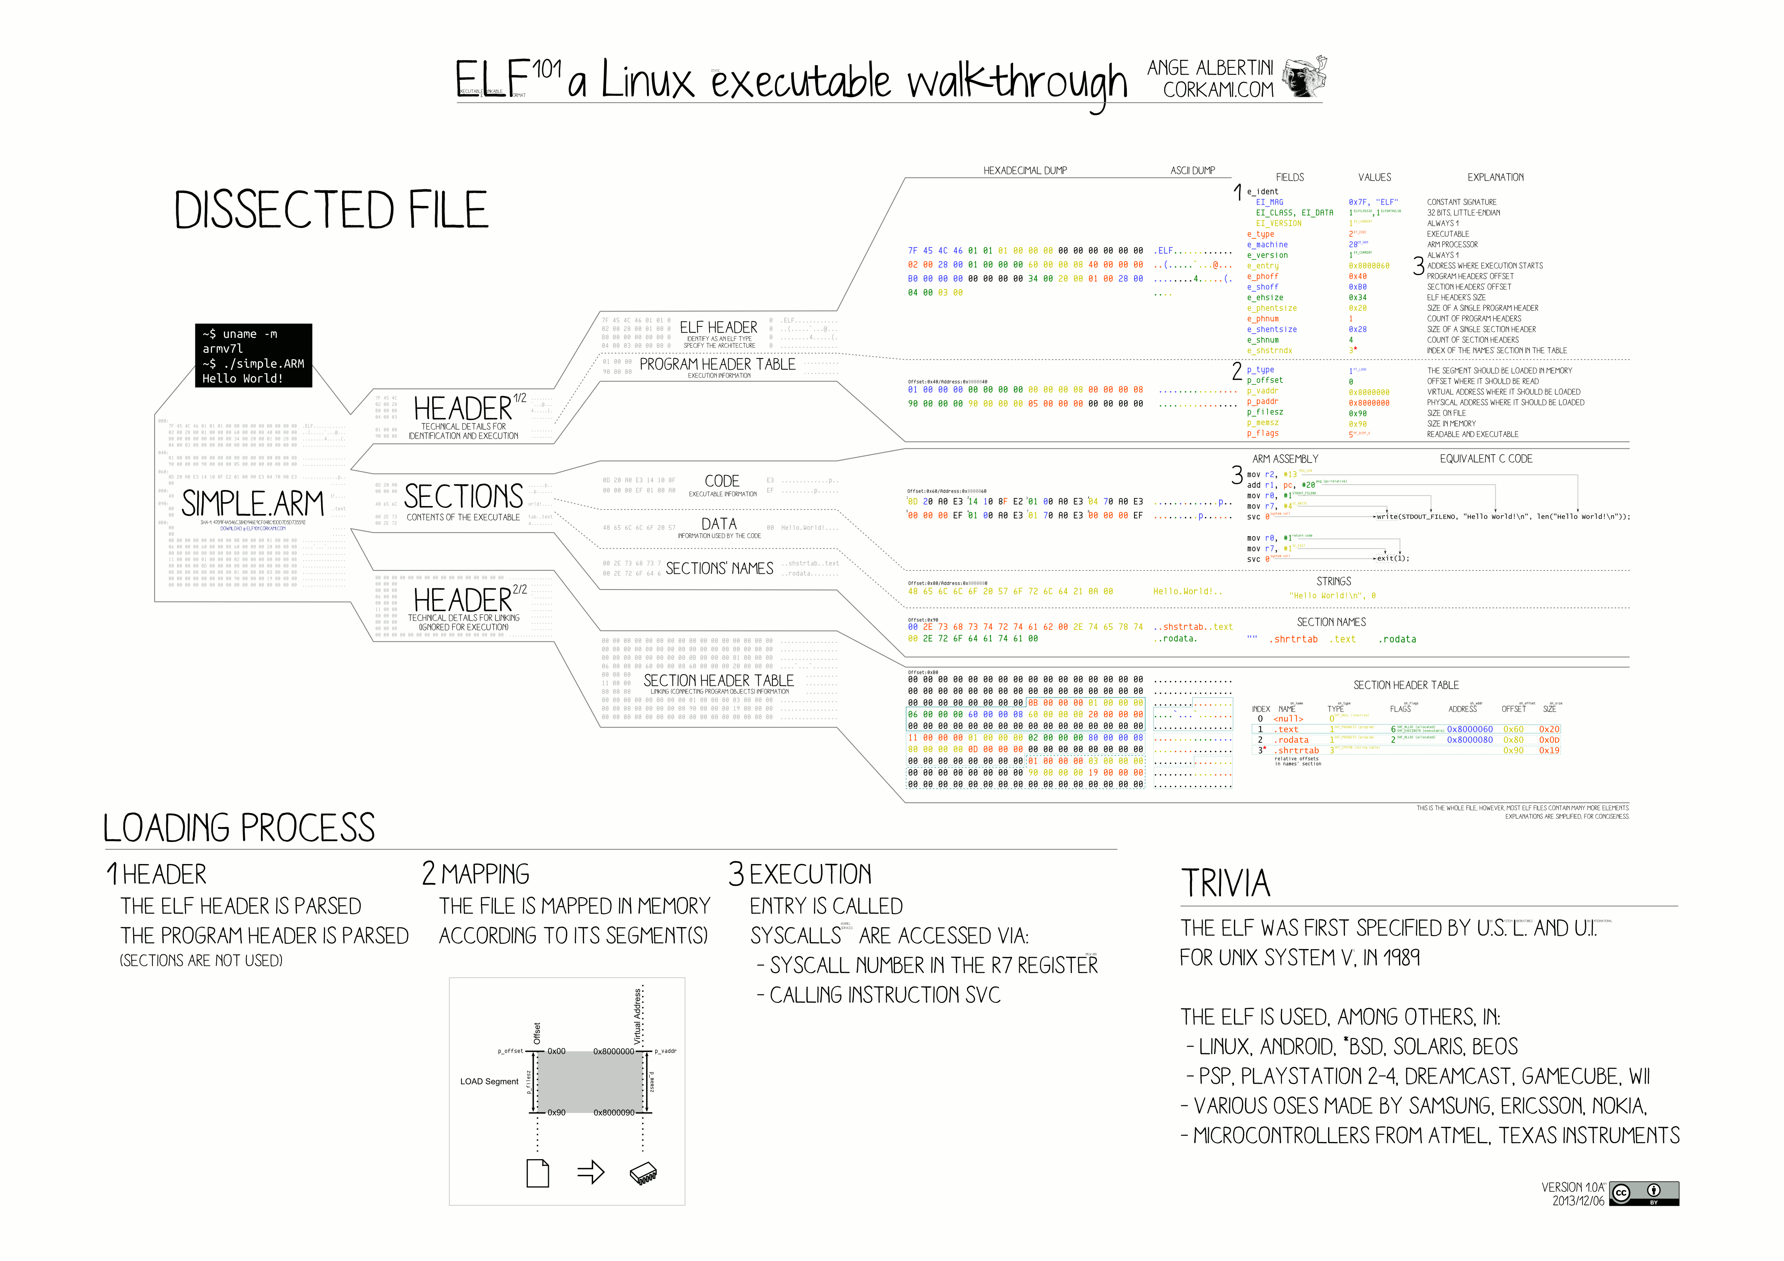

Slide 44
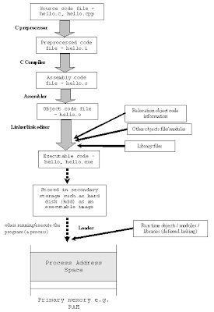
Considering the lifetime of a C program
Notes:
Image from: https://nyuray.blogspot.com/2009/01/compilers-assemblers-linkers.html

Slide 45
Additional reading
Why does the world need more programming languages?
https://www.fastcompany.com/3031443/why-does-the-world-need-more-programming-languages
Interactive language influence network:
https://exploringdata.github.io/vis/programming-languages-influence-network/
The programming languages weblog:
http://lambda-the-ultimate.org/
Interview with Alan Kay:
http://www.drdobbs.com/architecture-and-design/interview-with-alan-kay/240003442?pgno=1
“SICP”: https://mitpress.mit.edu/sicp/
The Dragon Book

